Slide 1
Work Update Hydrogen Deployment and Fleet Optimization
Week of 7/3

Slide 2
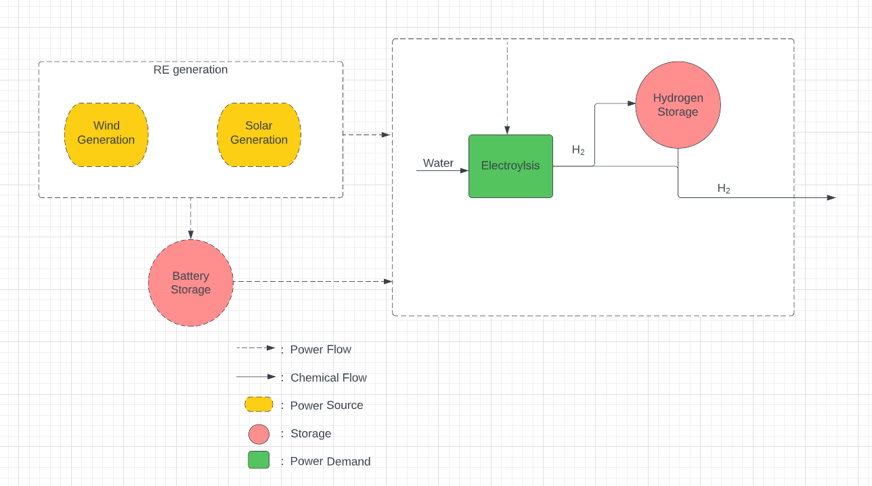
Created Hydrogen Model to compare with ammonia side

Slide 3
LCOH Output of Production Model Schematic

Slide 4
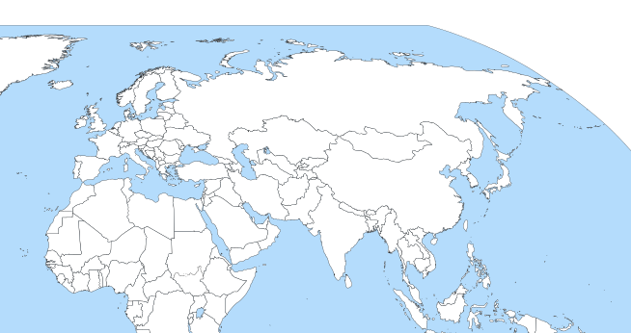
Network Model difficulties: runtime

Slide 5
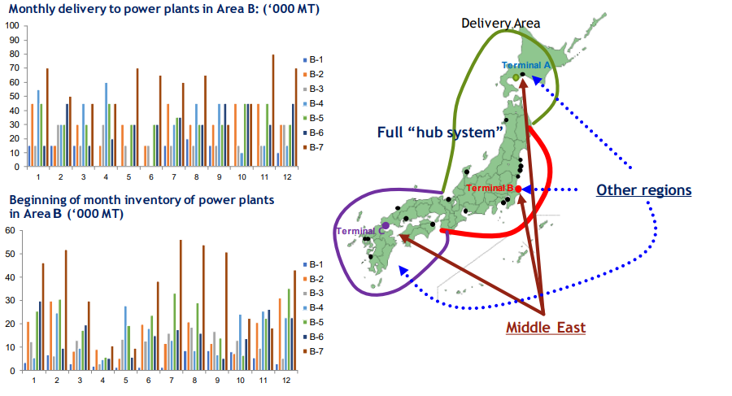
Converting ship modeling from network microscopic to general mesocopic analysis

Slide 6
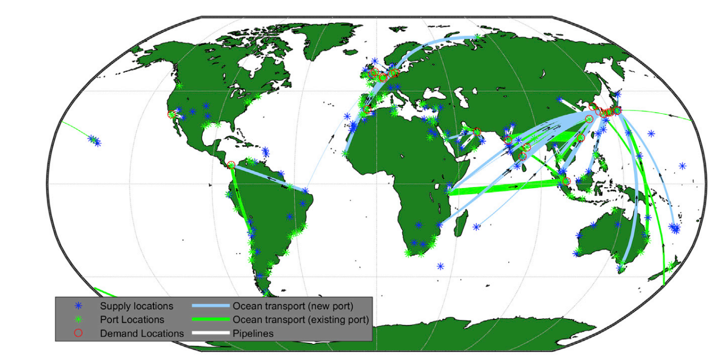
Model output vision: dynamic representation of ammonia flows around the world in conjunction with dynamic production
Visualize the output of green ammonia flows from production in KSA
Resolution can go down to daily or even hourly for ammonia flows
Can decrease # of ports for model runtime
From: Salmon, Nicholas, René Bañares-Alcántara, and Richard Nayak-Luke. "Optimization of green ammonia distribution systems for intercontinental energy transport." Iscience 24.8 (2021): 102903.

Slide 7
Next Steps
Finish recalibrated model validation
After working through the travails of the prior model, the rebuilt network flow is done and now visualizing
Gather real world data once model validation done
Explore cracking heatmaps in country (where centralized vs decentralized takes place)

